Slide 1




Ethiopia Socioeconomic Panel Survey
Data Use
January 26, 2024
Presented by Ethiopian Statistical Service (ESS) and
World Bank Living Standards Measurement Study (LSMS) Program
Notes:
Note:
This presentation is about the ESPS data use. It was presented at the ESPS Dissemination Workshop in Addis Ababa on 26 January 2024 .

Slide 2
Outline
Downloads
Data Use : How are the ESPS data used?
Official statistics and policy documents
Design and evaluation of large-scale development projects in several sectors
Sector-specific project design
Sector-specific program evaluation
Empirical studies
Sector-specific and economy-wide assessments
Policy research articles
Key takeaways
ESPS Data Use

Slide 3
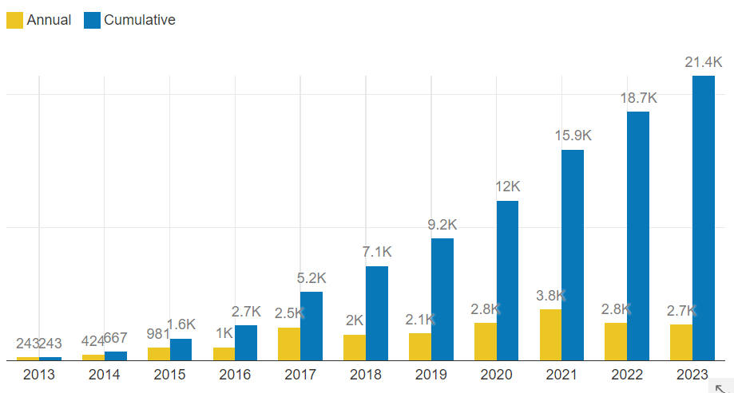
Over 21,000 ESPS data downloads since 2013
ESPS Data Use
Notes:
Note:
The cumulative download between 2013 and 2023 stood at over 21,000, with nearly 3K annual downloads in the recent years, translating to approximately 10 downloads per day.

Slide 4
ESPS data for official statistics and policy documents
Official Statistics: Sustainable Development Goals (SDGs)
ESPS data is used to establish baseline and progress SDG indicators in Agriculture, Gender, Water and others.
Policy Document: Financial Inclusion
National Bank of Ethiopia and Ethiopian Statistical Service collaborated.
Relevant questions were added to ESPS to inform the National Financial Inclusion Strategy.
Policy Document: Government of Ethiopia /World Bank Country Partnership Framework
ESPS - listed as one of the data sources for project design, progress monitoring and evaluation of achievements of the CPF.
ESPS Data Use
Notes:
Note:
A few key examples of ESPS data use in official statistics and policy documents.

Slide 5
ESPS data for sector-specific project design: Education
Ethiopia Human Capital Operation ($405m): To improve learning outcomes and nutrition services for girls and boys.
Ethiopia General Education Quality Improvement Program for Equity ($652m): To enhance internal efficiency, equitable access, and quality in general education.
Ethiopia Education and Skills for Employability Project ($200m): To improve employment outcomes of the TVET system of Ethiopia with a focus on women and marginalized groups.
Ethiopia Education Transformation Program for Results ($400m): To increase equitable access to quality pre-primary, primary and middle school education.
ESPS Data Use
Notes:
Notes:
These human capital /education projects are recently approved projects.
The project development objectives of these projects are about improving learning and nutrition outcomes and equity at individual level.
Availability of individual level information in the ESPS data is key to measure the various indicators listed in these projects.
These projects also used data from other surveys. However, ESPS data are also extensively used.

Slide 6
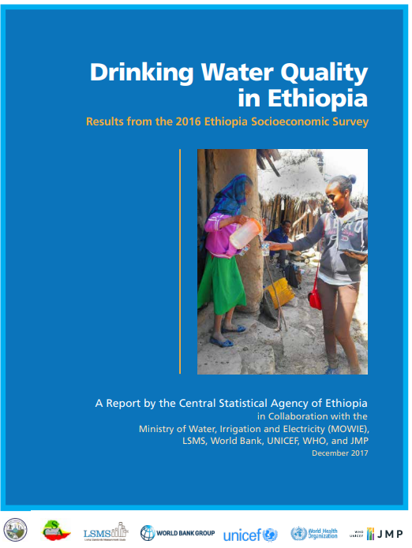
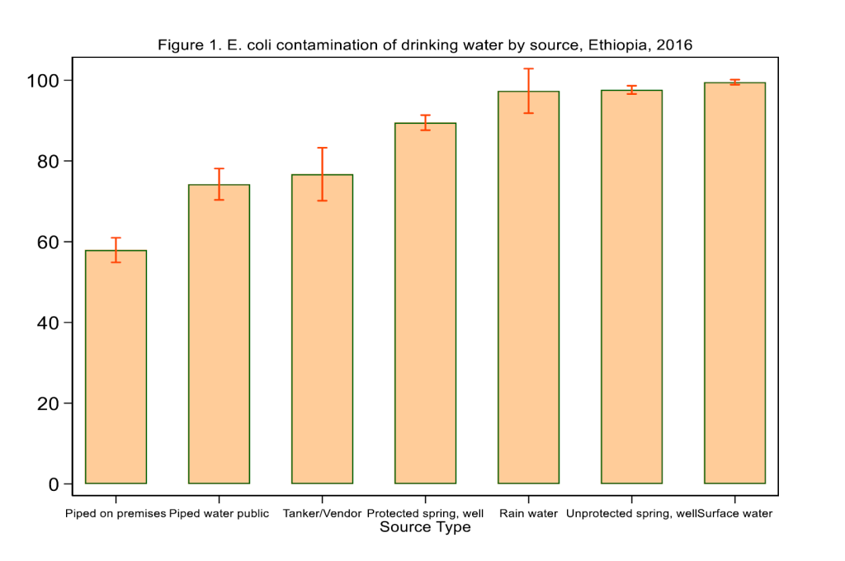
ESPS data for sector-specific project design: WASH
Survey: ESPS 2015/16 implemented the first large-scale water quality testing in Ethiopia.
5 agencies collaborated to obtain water samples from ~5000 households tested for biological (E. coli) and chemical contaminants
Result: Improved sources are not necessarily safe sources!
ESPS Data Use
Notes:
Notes:
The picture is the survey report’s front cover page.
The chart is from Using geospatial data & machine learning to predict water quality in Ethiopia (worldbank.org)

Slide 7
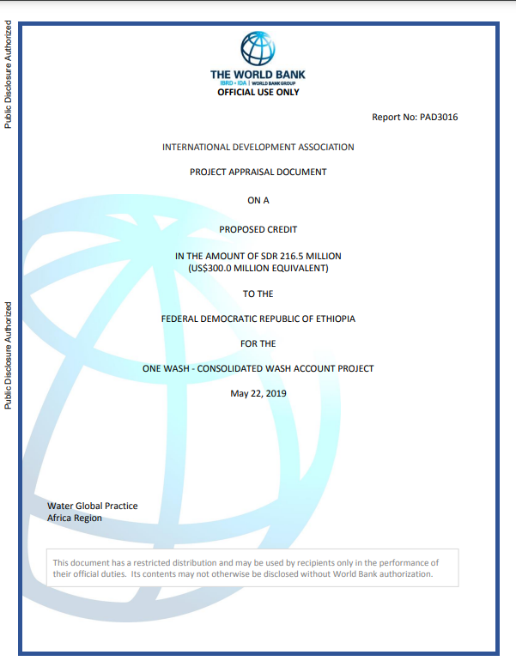
ESPS data for sector-specific project design: WASH (2)
What was the response?
Government /WB approved a $300m drinking water quality focused project under: One Wash.
Objective - increasing access to safe water supply, sanitation, and hygiene services.
Results monitoring indicator: # of people accessing water services that is free from fecal and priority chemical contamination.
ESPS Data Use
Notes:
Note:
The picture is the project’s appraisal document front page.

Slide 8

ESPS data for sector-specific program evaluation: Agriculture
ATA’s contribution over 10 years in terms of:
Improving access to agricultural technologies.
Reducing gender inequalities in agriculture.
Findings
“The ATA’s work has demonstrably improved agricultural household take up of a range of modern inputs….”
“Female-headed households disproportionately gained from priority area interventions (fertilizer and extension), but not [from] other[s]...”
Why ESPS data?
It is panel and available over 10 years
Detailed agricultural information collected in a multi-topic framework.
ESPS Data Use
Notes:
Source: Ten years of the Ethiopian Agricultural Transformation Agency (fao.org)

Slide 9








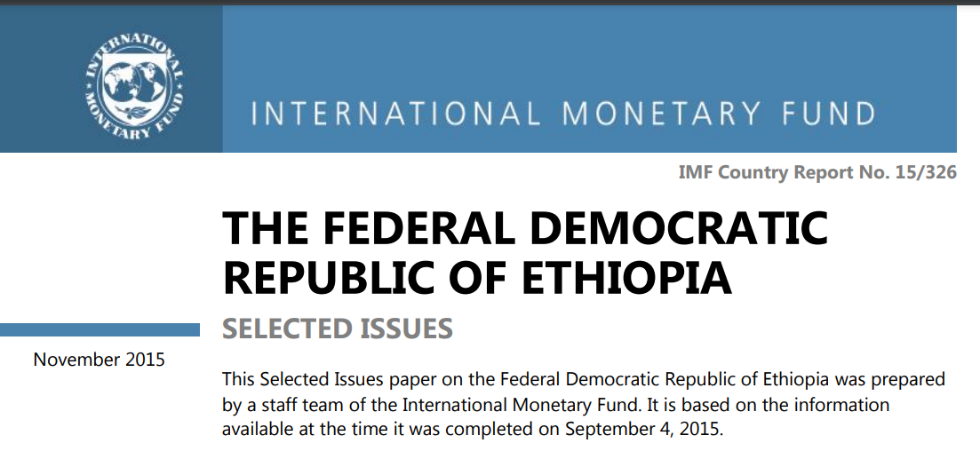
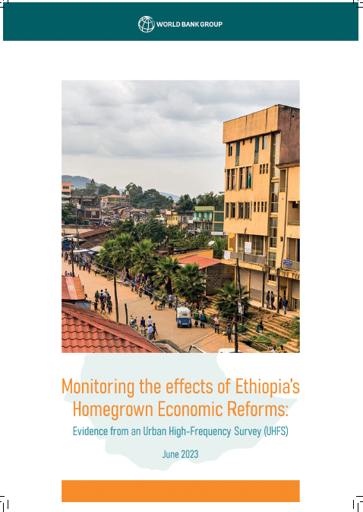
ESPS data for sector-specific and economy-wide studies
Financial Inclusion
WASH Diagnostics
Gender
Taxation
Rural Income
SPIA/CGIAR on Ag innovations
Poverty Assessment
Homegrown Econ Reform
IMF Policy Note
Welfare Impacts
ESPS Data Use
Notes:
Notes:
These studies are examples of recently published sector-specific and economy-wide assessment reports..
The examples show how ESPS data are used in key economy wide and sector-specific assessments.
Some of the reports mentioned here also used other data sources in addition to ESPS data.
The background figures (with out the added text labels) are front cover pages of those reports downloaded at different dates in January 2024 by title search.

Slide 10
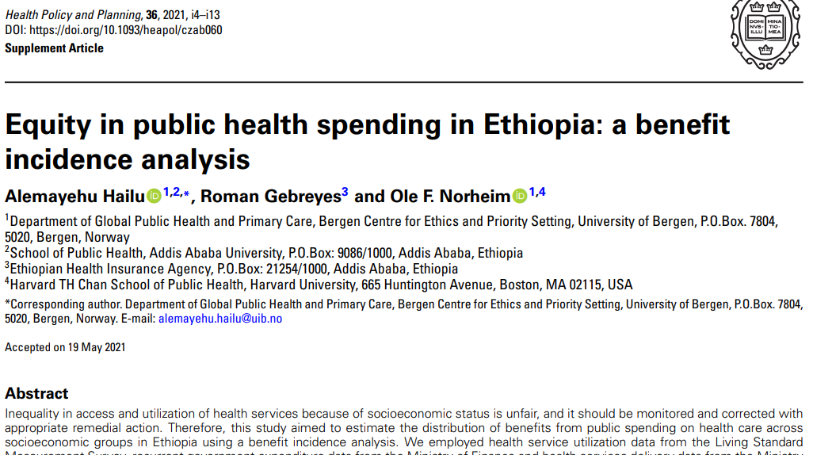
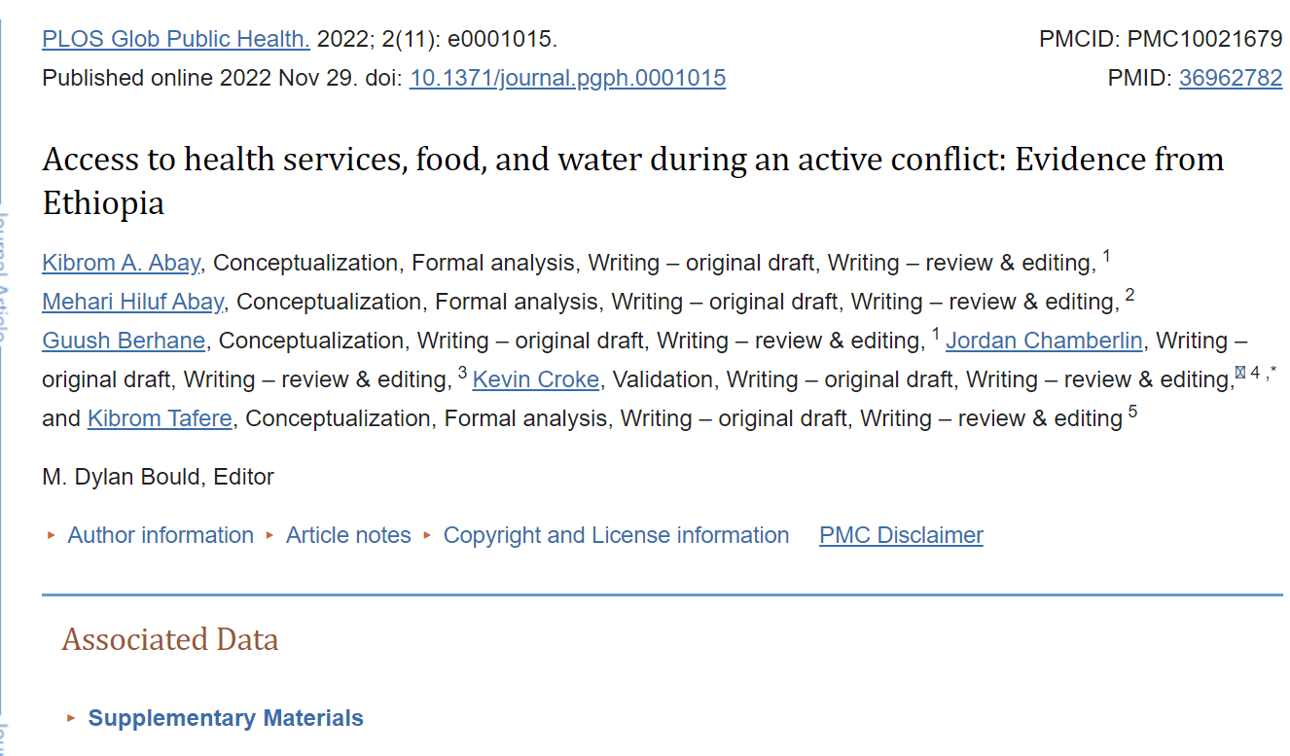
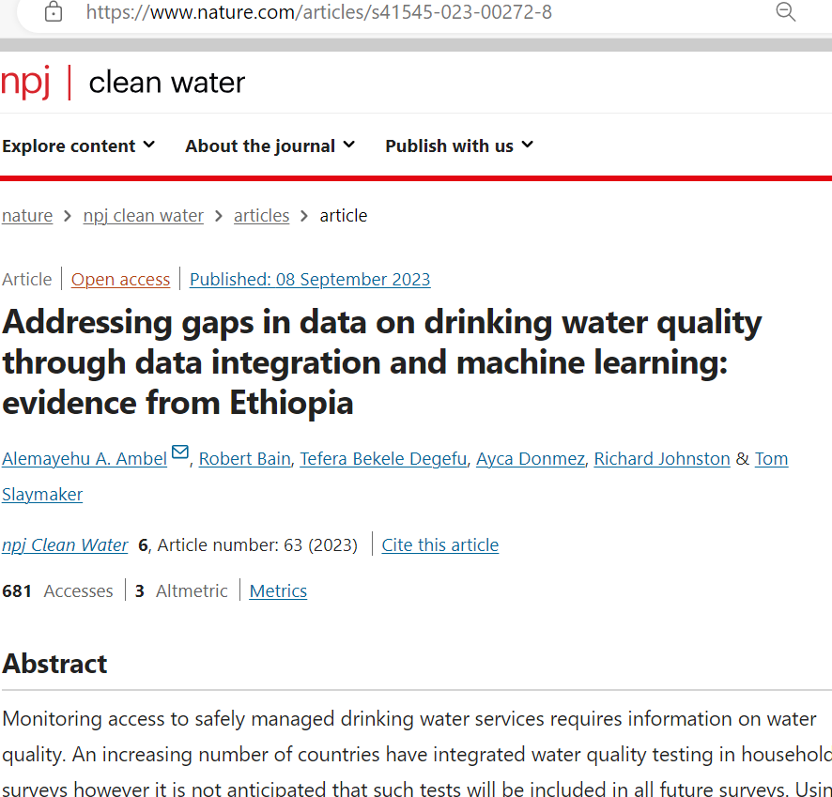
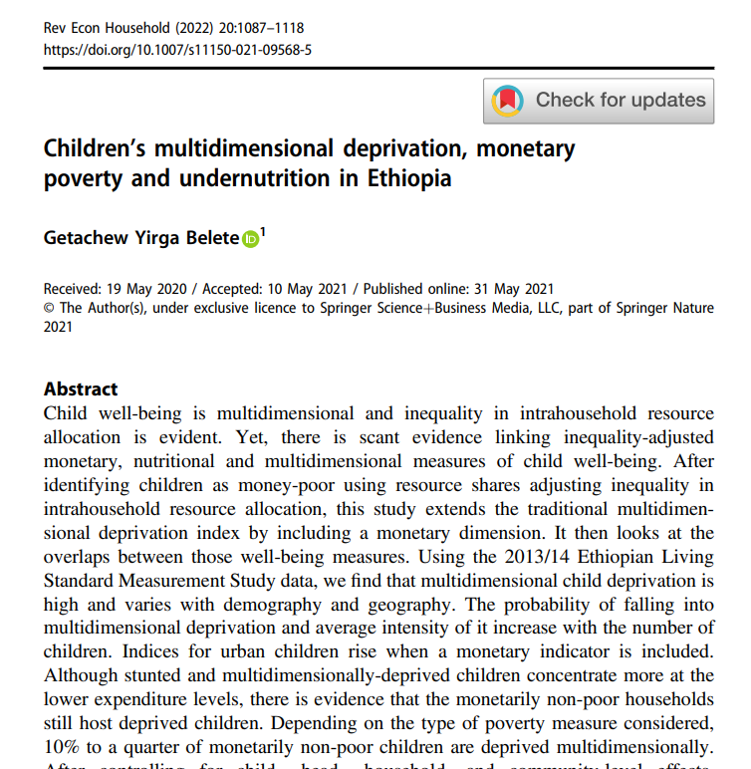
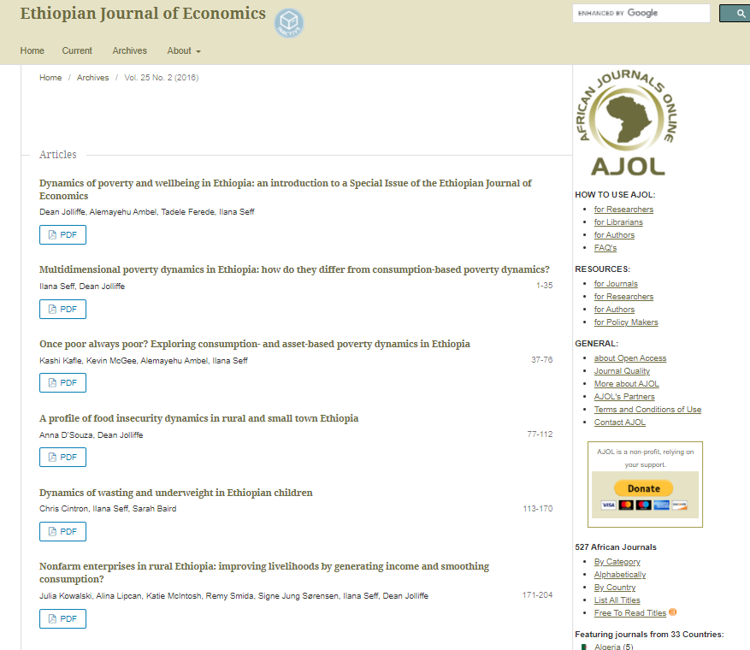
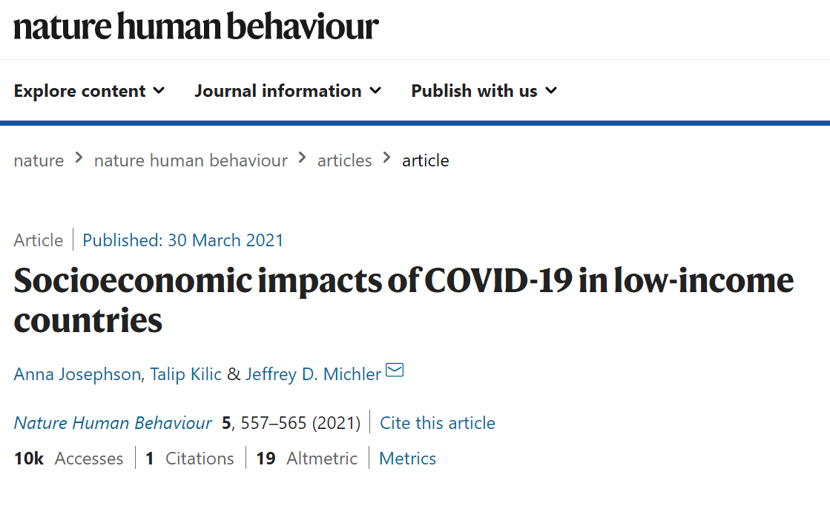

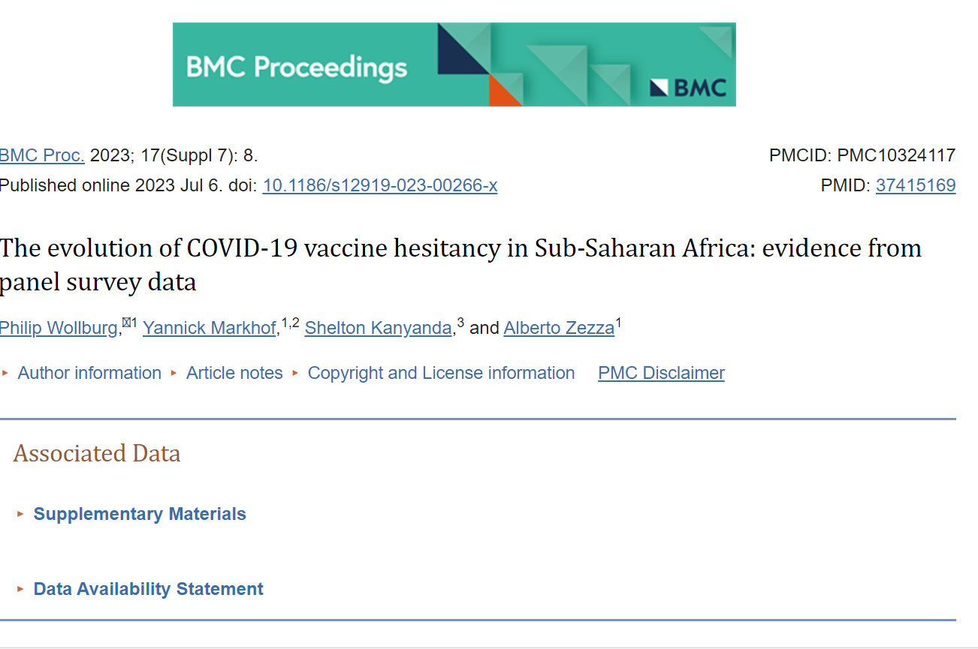
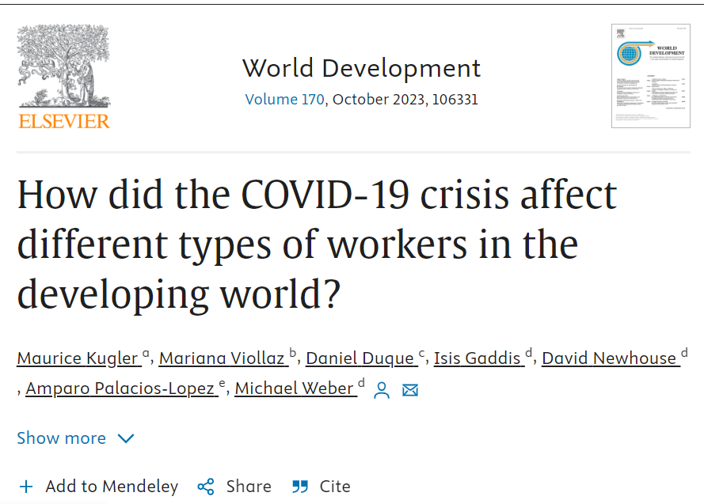
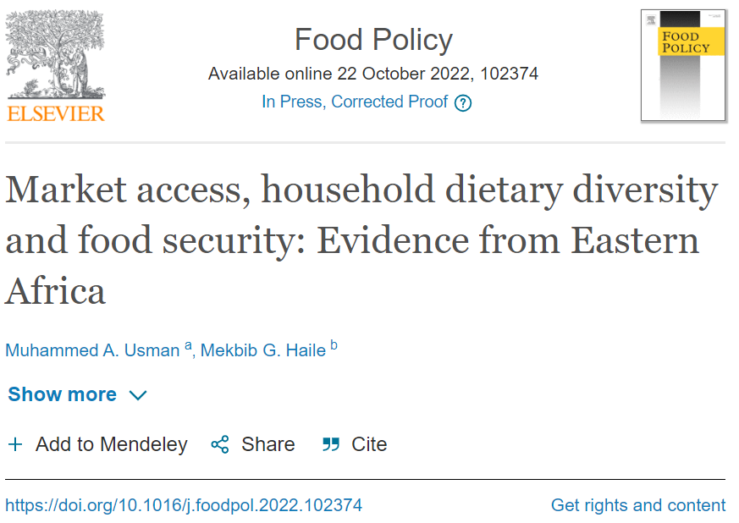
ESPS data for research: 560+ publications
Country specific- Ethiopia only - studies
Health +
Fiscal Policy
Child Poverty + Nutrition
Welfare Dynamics
Conflict
Water
Cross-country studies
COVID impacts
Migration
Vaccinations
Employment
Food Security
ESPS Data Use
Notes:
Notes:
There are over 560+ publications and these are just a few examples.
Ethiopia specific and cross-country studies.
Diverse and relevant topics at national and global levels.
High quality products in high impact journals.
Face-to-face and high frequency phone survey data integrated.
The background figures (without the added text labels) are front pages of those articles downloaded at different dates in January 2024 by title search.

Slide 11
Selected findings from assessments and policy research outputs
A health benefit incidence study (Ethiopia):“The rich benefited most from subsidies to hospital level services and for inpatient services. Subsidies to health centers were slightly pro-poor.” (Hailu, Gebreyes, Norheim 2021)
A migration study (Tanzania, Ethiopia, Malawi, Nigeria, and Uganda): “ Rural transformation and poverty reduction programs should use caution because such programs can increase economic inequality, which further increases migration flow.” (Kafle, Benefica, Winters 2020)
A food security and market access study (Ethiopia and Tanzania): “Households located closer to market centers spend more on total household consumption expenditure, consume more diverse diets, and are less food insecure…” (Usman and Haile 2022)
ESPS Data Use
Notes:
Note: Quotes taken from selected studies.

Slide 12
Selected findings from policy research outputs
A drinking water quality study (Ethiopia): “Drinking water quality can be predicted from demographic, socioeconomic, and geospatial variables that are often available in household surveys.” (Ambel et al. 2023)
Homegrown Economic Reform Evaluation “The [electricity] tariff increases had a disproportionately high negative effect on low-income households.” (world Bank 2023)
A vaccine hesitancy study (Burkina Faso, Ethiopia, Malawi, Nigeria, and Uganda): “Women, better educated individuals and those living in better-off households are more likely to express vaccine hesitancy.” (Wollburg et al. 2023)
ESPS Data Use

Slide 13
Key takeaways
The ESPS data are widely used in official statistics, policy documents, project design, program evaluations, and research.
This is possible thanks to key features of the ESPS data:
Open – publicly available
Representative- national, rural/urban, regional
Longitudinal tracking of households and individuals
Granular - collects individual-level and within-farm/plot-level information
Linked with high frequency phone survey data
Georeferenced – can be integrated with geospatial variables
ESPS Data Use

Slide 14




Stay connected with LSMS
Thank you
GET UPDATES
Worldbank.org/lsms
World Bank's Living Standards Measurement Study
lsms@worldbank.org

